Slide 1

AI-Based Social Media Sentiment and Trend Analysis Platform for Women’s Safety
FINAL YEAR B.TECH CAPSTONE PROJECT
PROJECT TEAM :
KAVYA NAYANA — 2300033848 INTI HANITHA SAI GAYATHRI — 2300032512 KOKKILIGADDA T.V. DURGA RAO — 2300032267 BADAM SUDHEER REDDY — 2300033278 GARIKAPATI SATYA KEERTHIKA — 2300030988
Guide: Mr. M. Subba Rao M-Tech
Assistant Professor, Department of Computer Science and Engineering
CSE-3 | BATCH-220
KL University | Department of Computer Science and Engineering | Academic Year 2026–27

Slide 2
PROBLEM AND MOTIVATION
• Women’s safety is an important social concern, and social media contains public discussions about incidents.
• Safety-related posts are often informal, unstructured and difficult to review manually.
• Large volumes of posts make it difficult to identify important information quickly.
• Repeated reports from the same location may not be obvious when posts are viewed separately.
• Different incidents can have different levels of concern and require suitable classification.
• A simple visual system is needed to understand safety patterns across time and locations.
• Our project uses AI and data analysis to organize these observations into useful insights.
• The system is designed as an academic prototype to support awareness and analysis.
Social Media → Large Data → Manual Analysis → Difficult
KL University | Department of Computer Science and Engineering | Academic Year 2026–27

Slide 3
PROBLEM STATEMENT
• Safety-related information is available across different social-media posts. • The information is not available in one organized form. • Identifying sentiment from a large number of posts is difficult manually. • Finding common incident patterns also requires detailed analysis. • Location-based safety information may be difficult to understand from individual posts. • There is a need for a simple platform to organize this information. • The project will explore AI-based text and trend analysis techniques. • The proposed idea will be studied and developed during the capstone project.
KL University | Department of Computer Science and Engineering | Academic Year 2026–27

Slide 4
LITERATURE SURVEY
We are currently studying existing research related to women’s safety. • Previous studies use social-media data for sentiment analysis. • NLP techniques are commonly used for processing social-media text. • Machine-learning methods are used for text classification. • Some studies analyze safety concerns based on location or incident type. • Research also explores visualization of social-media analysis results. • These studies help us understand suitable methods for our project. • The literature survey will help us finalize our project methodology.
AUTHORS:-
Sanjay Kumar et al. (2021) Research: Empowering Women Safety: Innovative App Leveraging Machine Learning and Flutter for Emergency They proposed a mobile-based women's safety application using Machine Learning and Flutter. The system focuses on emergency assistance, live location sharing, emergency contacts and crime-related prediction. This work shows how ML and mobile technology can provide quick assistance during dangerous situations.
KL University | Department of Computer Science and Engineering | Academic Year 2026–27

Slide 5
3. S. Gokulakrishnan et al. (2022) Research: Machine Learning of Twitter Feeds and Women Safety in Indian Cities The researchers used Machine Learning and Twitter/social-media data to study women's safety in Indian cities. Social-media information can help identify safety-related incidents, harassment and public concerns. This approach demonstrates how ML can analyse large amounts of online data for safety applications.
4. Ameelia Roseline Arundhuswamy et al. (2023) Research: GIZMO COP – An Intelligent Security Device for Women Safety with Machine Learning The researchers developed an intelligent safety device using Machine Learning. The proposed system includes technologies such as GPS/GSM, panic-button functionality and physiological sensors. It demonstrates how wearable and intelligent devices can automatically assist women during emergency situations.
5. Farha Parveen et al. (2023) Research: Analysis of Women Safety in Public Places Using Machine Learning on Tweets The researchers applied Machine Learning to Twitter data to analyse women's safety in public places. The system uses social-media information to understand safety concerns and public experiences. This research is useful for developing data-driven safety analysis systems.

Slide 6
6. Mohd Naved et al. (2022) Research: Artificial Intelligence Based Women Security and Safety Measure System The researchers proposed an AI-based security system for women's safety. Technologies such as GPS, GSM and intelligent monitoring can be used to identify emergencies and provide timely assistance. The research demonstrates the role of AI in improving traditional safety mechanisms.
7. Harshali Patil et al. (2023) Research: Role of Information Technology in Strengthening Women’s Safety in India The researchers studied technologies including Artificial Intelligence, IoT, surveillance systems, mobile applications and cybersecurity. Their work shows that women's safety can be improved by integrating multiple technologies rather than depending on a single system.
8. M. Navaneethakrishnan et al. (2023) Research: WoExP – Women Express: Artificial Intelligence Based Women Security and Safety System They proposed an AI-based women's security platform designed to help women report problems and obtain assistance. The system connects technology with emergency support and communication, showing how AI can help create a more responsive safety ecosystem.

Slide 7
8. Udipta Boro et al. (2024) Research: Data-intensive Technology Systems for Women Safety: Lessons from Bengaluru’s AI-powered CCTV Network The researchers examined AI-powered CCTV surveillance in Bengaluru. Their work discusses how intelligent surveillance can contribute to women's safety while also highlighting concerns such as privacy, surveillance, bias and discrimination. This is particularly relevant to an AI-based CCTV project.

Slide 8
PROPOSED IDEA
• Collect relevant social-media data related to women’s safety. • Clean and preprocess the collected text. • Analyze the sentiment of the posts using NLP techniques. • Classify posts based on the type of safety-related incident. • Study patterns based on time and available location information. • Present the analyzed information through a simple dashboard. • Explore potential risk-zone visualization based on available data. • Study the possibility of adding an IoT-based SOS wearable.
KL University | Department of Computer Science and Engineering | Academic Year 2026–27

Slide 9
PROPOSED DASHBOARD PROCESS
DATA Collection of relevant social-media posts or a suitable dataset related to women’s safety.
↓
DATA CLEANING Remove unwanted characters, duplicate posts, links and unnecessary information from the data.
↓
NLP ANALYSIS Process the text using Natural Language Processing techniques to understand the content.
↓
SENTIMENT & INCIDENT CLASSIFICATION Identify the sentiment and classify posts according to the type of safety-related incident.
↓
TREND ANALYSIS Study the frequency and changes in safety-related posts over different time periods.
↓
LOCATION ANALYSIS Analyze available location information to identify areas with repeated safety-related reports.
↓
DASHBOARD Present the analyzed information using charts, filters, trends and a map for easy understanding.
KL University | Department of Computer Science and Engineering | Academic Year 2026–27

Slide 10
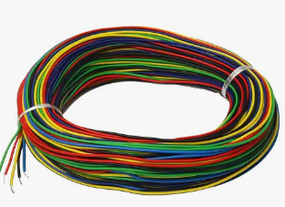
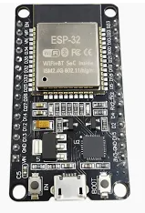
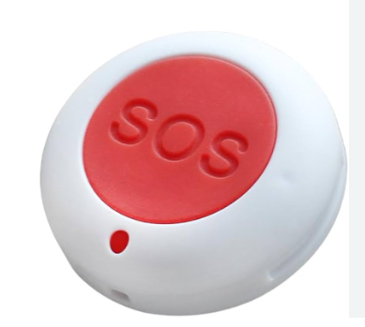
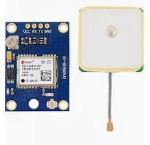
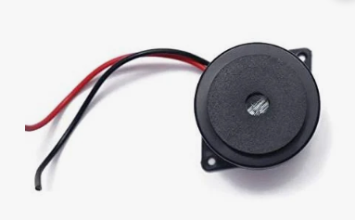
Project Cost Estimation (Hard Ware)
The proposed project is designed to be cost-effective for a final-year B.Tech prototype.
Most of the software tools used in the project are free and open-source.
The main expense is for the IoT-based wearable safety prototype.
The hardware includes ESP32, GPS module, SOS button, buzzer, battery and basic components.
The estimated hardware cost is approximately ₹1,900.
Depending on additional components, the total cost may range between ₹1,900 and ₹2,500.
No major software licensing cost is expected during development.
Estimated overall project budget: ₹1,900–₹2,500.
WIRE KIT COST: ₹300
ESP-32 Development Board
COST : ₹500
GPS Module (NEO-6M)
COST : ₹600
BUZZER COST : ₹60
SOS BUTTON
COST : ₹250
KL University | Department of Computer Science and Engineering | Academic Year 2026–27

Slide 11




Software Program Used
Frontend: React.js, HTML5, CSS3, JavaScript, Chart.js, Leaflet.js Backend: Python, FastAPI/Flask, REST API Database: MySQL AI/NLP: NLTK, VADER, Pandas, Scikit-learn, TF-IDF Development: VS Code, Git, GitHub, Postman

Slide 12
IoT WEARABLE AND SOS
ESP32 is used as the main controller for the proposed wearable prototype.
A GPS module provides the approximate location of the user.
The current location can be compared with selected potential risk zones.
An alert can be generated when the user enters a designated risk area.
A physical SOS button can create an emergency event in the prototype.
A buzzer or vibration motor can provide a local warning to the user.
Wi-Fi can be used for the initial prototype, with GSM or LTE as a future extension.
The wearable connects the project’s data analysis with a practical safety-assistance feature.
GPS
↓
ESP32
↙ ↘
BUZZER SOS BUTTON
↓ ↓
ALERT EMERGENCY
KL University | Department of Computer Science and Engineering | Academic Year 2026–27

Slide 13
DASHBOARD AND POTENTIAL RISK ZONES
Positive Negative Neutral
The dashboard provides a simple overview of the analyzed safety-related information.
Sentiment charts show positive, negative and neutral distributions.
Incident charts compare different types of reported safety concerns.
Time-based graphs show how reports change during selected periods.
A map view can display the geographic concentration of analyzed reports.
Filters allow users to select time period, location and incident type.
Potential high-risk zones can be highlighted using repeated reported-data patterns.
The dashboard makes the project results easier for users and mentors to understand
INCIDENT ANALYSIS
LOCATION / MAP
KL University | Department of Computer Science and Engineering | Academic Year 2026–27

